Slide 1
BJ0F Assignment : PointPoint
Designing PowerPoint Slides
Bao Qingjun
287297138@qq.com

Slide 2
Outline
Introduction
Subsection 1
Subsection 2
Results 1
Results 2
Results 3
Subsection 1
Subsection 2
Subsection 3
Conclusions
Recommendations

Slide 3
Introduction
Subsection 1
Subsection 2

Slide 4
Introduction : Subsection 1
Process 1
Step 1
Step 2
Process 2
Step 1
Process 3
Step 1
Step 2
Step 2

Slide 5
Introduction : Subsection 2
Champlain RAC Website

Slide 6
Results
Results 1
Results 2
Results 2

Slide 7
Results 1
Examples | Criteria 1 | Criteria 2 | Criteria 3
Example 1 | 15 000 | 15 000 | 20 000
Example 2 | 12 000 | 13 000 | 17 000
Example 3 | 13 000 | 17 000 | 15 000

Slide 8
Results 2

Slide 9
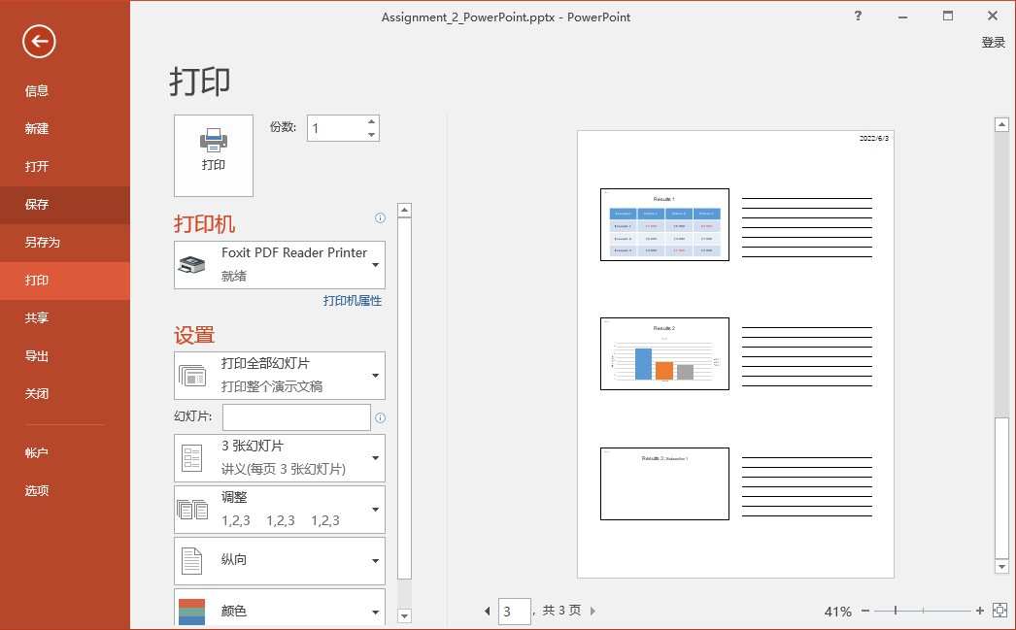
Results 3 : Subsection 1

Slide 10
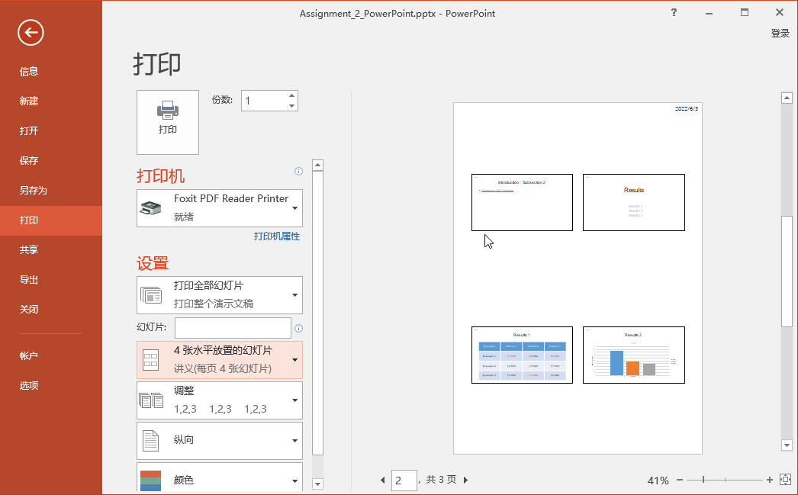
Results 3 : Subsection 2

Slide 11
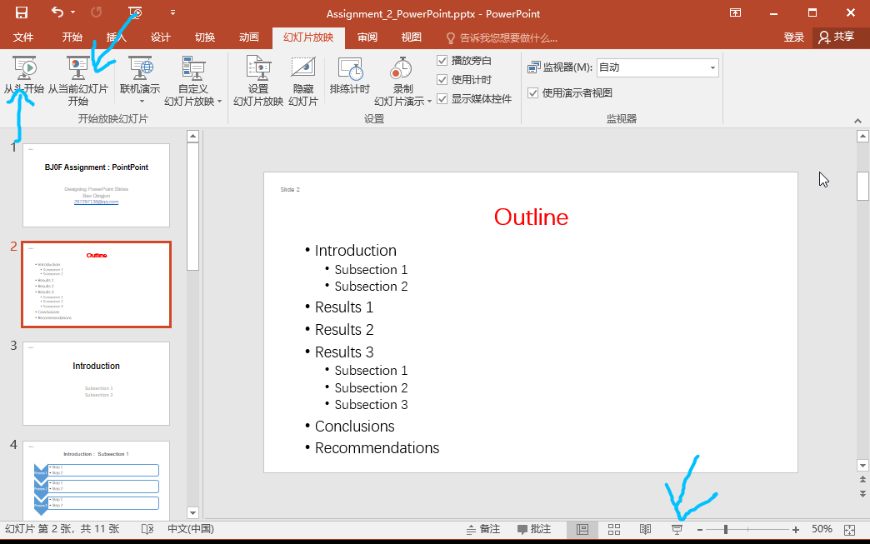
Results 3 : Subsection 3

Slide 12
Conclusions and Recommendations

Slide 13
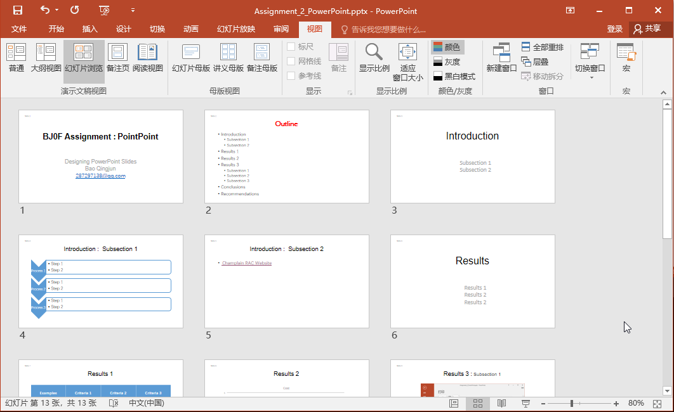
Conclusions

Slide 14
Recommendations

Slide 15

Questions

Slide 16
Thank you

